Slide 1


Battery
Buck Converter
Left Leg
Servo 1
Servo 2
Radio Transmitter
Radio Receiver
Arduino Nano
Right Leg
Servo 3
Power Transfer
Servo 4
Data transfer

Slide 2
20°
50°

Slide 4
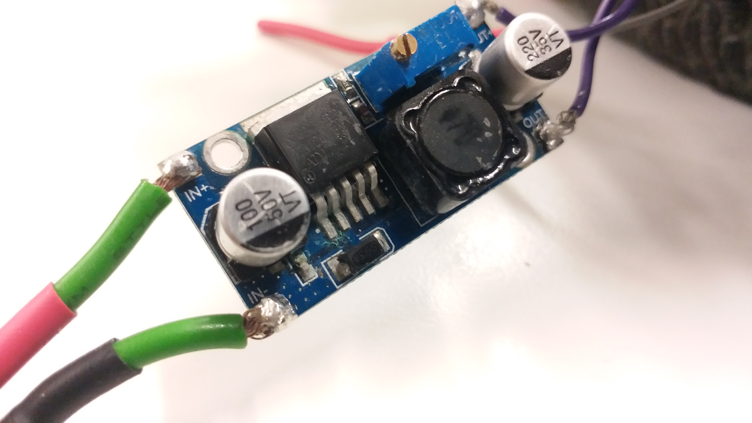

Slide 5


$$θ$$
$$θ$$
5 | 10 | 15 | 20 | 25 | 20 | 15 | 10

